Slide 1

Green Pace
Security Policy Presentation
Developer: Kelly Lewis

Slide 2

OVERVIEW: DEFENSE IN DEPTH
The primary goal of a Defense In Depth policy is to create a defensive strategy that puts a multi-layered barrier that covers the deficiencies of each previous layer.

Slide 3
THREATS MATRIX
Threats are categorized by a multitude of factors…
All are important.
Ranked system to prioritize threats.
Likely STD-009-CPP | Priority STD-004-CPP
Low priority STD-001-CPP | Unlikely STD-002-CPP

Slide 4
10 PRINCIPLES
Validate Input Data: STD-003-CPP
Heed Compiler Warnings: STD-001-CPP
Architect and Design for Security Policies: STD-007-CPP, STD-008-CPP, STD-010-CPP
Keep it Simple: STD-002-CPP
Default Deny: Always code to deny access by default.
Adhere to the Principle of Least Privilege: Users can access only what they need to.
Sanitize Data Sent to Other Systems: Ensure data is safe before transmission.
Practice Defense in Depth: STD-004-CPP
Use Effective Quality Assurance Techniques: STD-006-CLG
Adopting a Secure Coding Standard: STD-005-CPP, STD-009-CPP

Slide 5
CODING STANDARDS
Coding Standard | Label | Name of Standard
SQL Injection | STD-004-CPP | Exclude user input from format strings
Containers | STD-009-CPP | Guarantee that container indices and iterators are within the valid range
String Correctness | STD-003-CPP | Use valid references, pointers, and iterators to reference elements of a basic_string
Memory Protection | STD-005-CPP | Allocate sufficient memory for an object
Object Oriented Programming (OOP) | STD-010-CPP | Do not use pointer-to-member operators to access nonexistent members
Assertions | STD-006-CLG | Understand the termination behavior of assert() and abort()
Input / Output | STD-008-CPP | Close files when they are no longer needed
Exceptions | STD-007-CPP | Handle all exceptions
Data Type | STD-001-CPP | Do not declare or define a reserved identifier
Data Value | STD-002-CPP | Do not rely on side effects in unevaluated operands
(Ordered by Severity -> Likelihood ->Remediation Cost)

Slide 6
ENCRYPTION POLICIES
Encryption In Rest:
Encrypt data that is stored.
Example: Primary Database
Encryption at Flight:
Encrypt data that is being transferred.
Example: E-mail, remote access, file transfers.
Encryption in Use:
Encrypt data that is actively being accessed.
Example: editing user information, company account records.

Slide 7
TRIPLE-A POLICIES
Triple A is…
Authentication: Verify users, confirm user identities.
Authorization: System roles, only allow users to access what they need to.
Accounting: Log user access and actions.

Slide 8
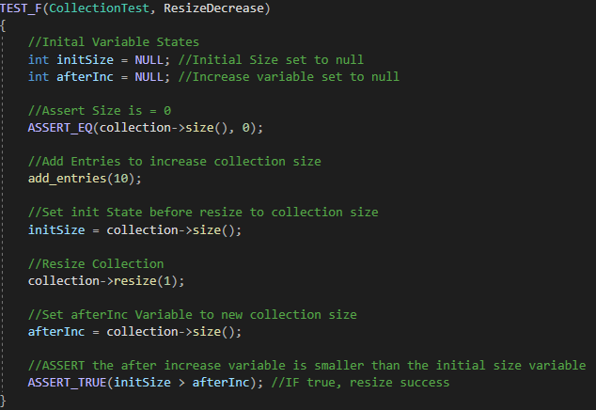

Check If Resize Decreases Collection Size
(Unit Test Code)
(Results)

Slide 9
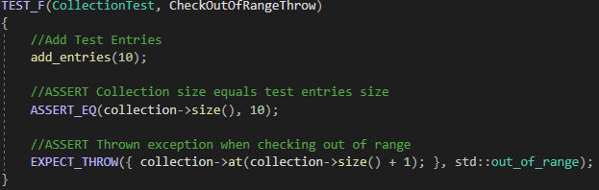
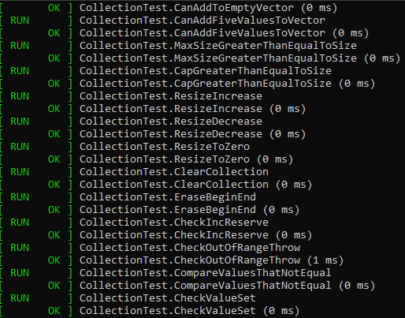
Check If Collection Location is Out of Range and Throws Exception
(Unit Test Code)
(Results)

Slide 10
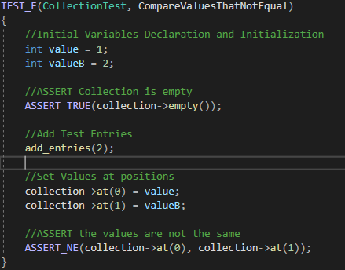
Check to Compare That Set Values are Not Equal
(Unit Test Code)
(Results)

Slide 11
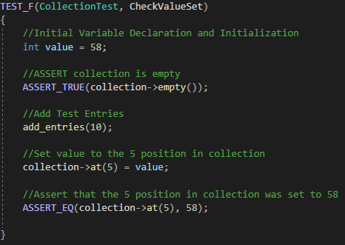
Check that Value was Set at Specific Location
(Unit Test Code)
(Results)

Slide 12

AUTOMATION SUMMARY

Slide 13
TOOLS
DevSecOps: This pipeline shows the integration of Security into SDLC.
Tools: Testing and monitoring security is used throughout the development pipeline. These tools are designed to cover various security frameworks with an emphasis on automation. The tools are used to monitor software for vulnerabilities throughout the SDLC.

Slide 14
RISKS AND BENEFITS
Acting Now vs Waiting…
Acting Now: If developers and designers act now to implement security policies, standards, and practices, then costly errors/ issues can be mitigated. Adds a bit more to cost with maximum return.
Waiting: While costs, both time and money, are reduced for the sake of general product enhancements or features. Security is put on the back burner to be handled either just before deployment or after. Increases security risks and vulnerabilities on release.
Don’t Leave Security to the End.

Slide 15
RECOMMENDATIONS
These recommendations are based on a lack of direct standards in this current policy with examples.
Default Deny: Always code to deny access by default.
Adhere to the Principle of Least Privilege: Users can access only what they need to.
Sanitize Data Sent to Other Systems: Ensure data is safe before transmission.

Slide 16
CONCLUSIONS
Security should not be left to the last minute.
SEI CERT security recommendations, rules, and examples should be referenced by all developers.
As new features and implementations are adopted, security should be re-addressed.
Additional Standards:
Default Deny: Create standard with example of default denial.
Adhere to the Principle of Least Privilege: Create standard that shows user access and roles.
Sanitize Data Sent to Other Systems: Create standard that shows file/ data transfer sanitization.

Slide 17
REFERENCES
Seacord, R. C. (2013). Secure Coding in C and C++, 2nd Edition. [VitalSource Bookshelf version]. Retrieved from vbk://9780132981972
Sei cert C++ coding standard. SEI CERT C++ Coding Standard - SEI CERT C++ Coding Standard - Confluence. (n.d.). https://wiki.sei.cmu.edu/confluence/pages/viewpage.action?pageId=88046682

